Slide 1
Indexing-Sharding and Replication in MongoDB
By – Jigna Patel

Slide 2
MongoDB Indexes
In MongoDB, querying without indexes is called a collection scan. A collection scan will:
Result in various performance bottlenecks
Significantly slow down your application
Notes:
Indexes provide efficient way of querying data. When querying data without indexes, the query will have to search for all the records within a database to find data that match the query.

Slide 3
What are indexes in MongoDB?
Indexes are special data structures that store a small part of the Collection’s data in a way that can be queried easily.
In simplest terms, indexes store the values of the indexed fields outside the table or collection and keep track of their location in the disk. These values are used to order the indexed fields.
This ordering helps to perform equality matches and range-based query operations efficiently. In MongoDB, indexes are defined in the collection level and indexes on any field or subfield of the documents in a collection are supported.

Slide 4
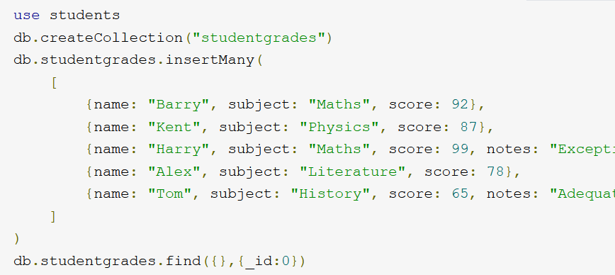
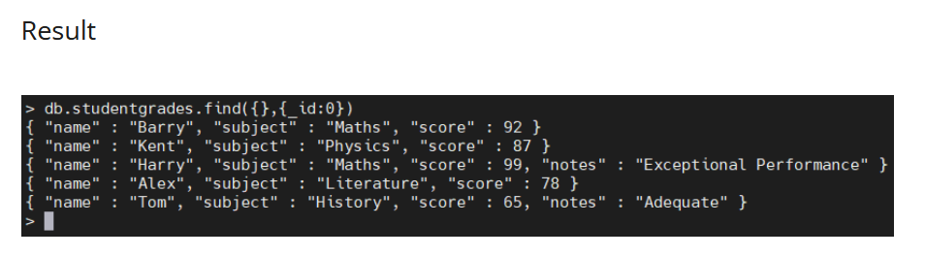

Slide 5
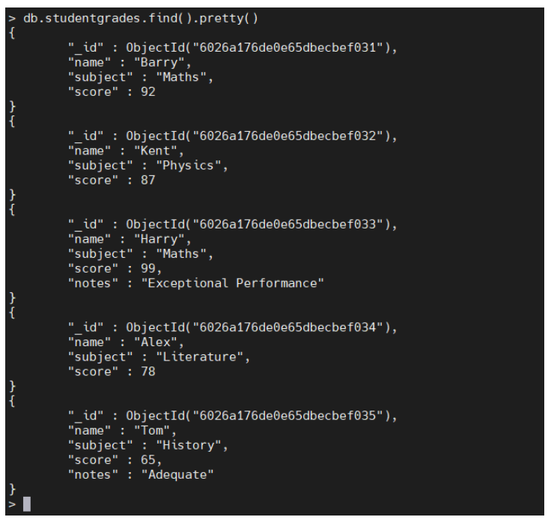
Creating indexes
When creating documents in a collection, MongoDB creates a unique index using the _id field. MongoDB refers to this as the Default _id Index. This default index cannot be dropped from the collection.
see the _id field which will be
utilized as the default index:
Notes:
Now let’s create an index. To do that, you can use the createIndex method using the following syntax:

Slide 6
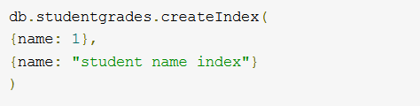
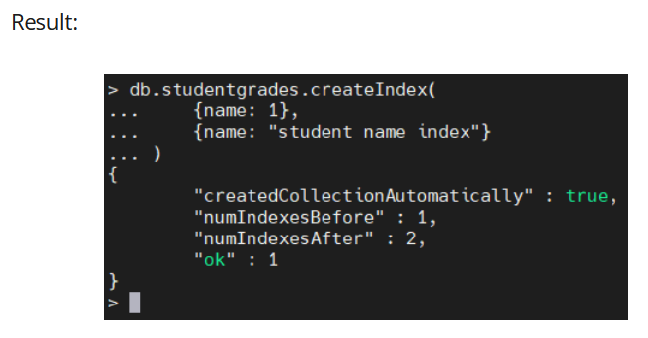
Syntax : db.<collection>.createIndex(<Key and Index Type>, <Options>)
When creating an index, you need to define the field to be indexed and the direction of the key (1 or -1) to indicate ascending or descending order.
Indexes cannot be renamed after creation. (The only way to rename an index is to first drop that index and recreate it using the desired name.)
Let’s create an index using the name field in the studentgrades collection and name it as student name index.

Slide 7
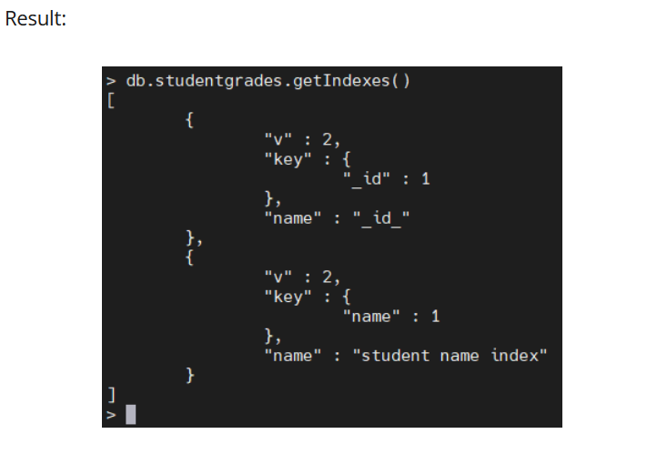
Finding indexes
You can find all the available indexes in a MongoDB collection by using the getIndexes method.
Syntax: db.<collection>.getIndexes()

Slide 8
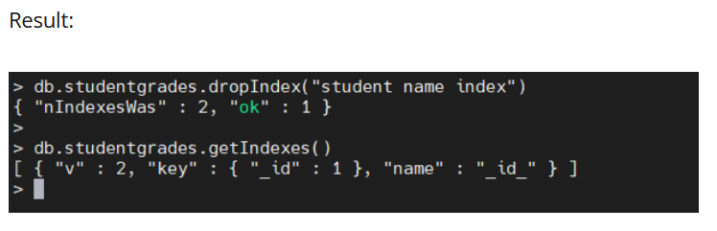
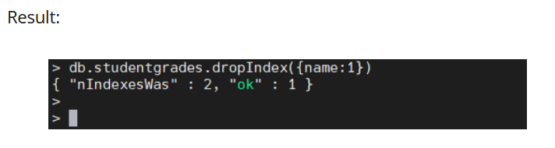
Dropping indexes
To delete an index from a collection, use the dropIndex method while specifying the index name to be dropped.
Syntax : db.<collection>.dropIndex(<Index Name / Field Name>)
Let’s remove the user-created index with the index name student name index, as shown below.
Notes:
You can also use the index field value for removing an index without a defined name:

Slide 9
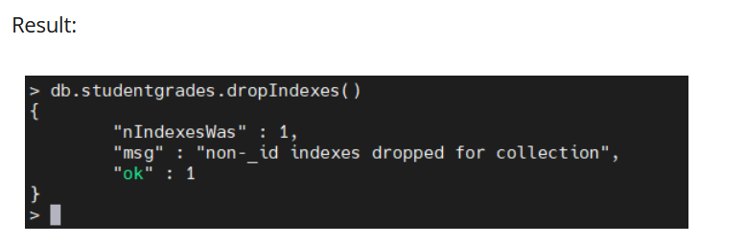
The dropIndexes command can also drop all the indexes excluding the default _id Index.

Slide 10
Common MongoDB index types
MongoDB provides different types of indexes that can be utilized according to user needs. Here are the most common ones:
Single field index
Compound index
Multikey index

Slide 11
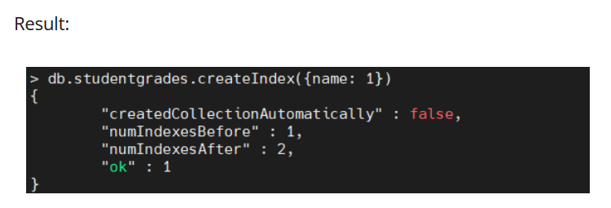
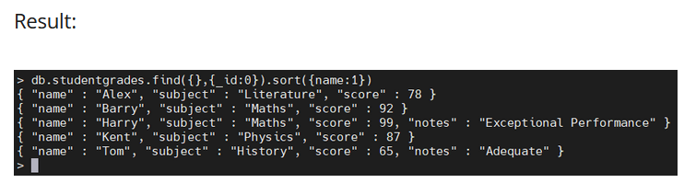
Single field index
These user-defined indexes use a single field in a document to create an index in an ascending or descending sort order (1 or -1).
In a single field index, the sort order of the index key does not have an impact because MongoDB can traverse the index in either direction.
You can use the sort() method to see how the data will be represented in the index.

Slide 12
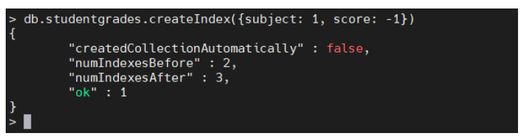
Compound index
You can use multiple fields in a MongoDB document to create a compound index.
This type of index will use the first field for the initial sort and then sort by the preceding fields
In the above compound index, MongoDB will:
First sort by the subject field
Then, within each subject value, sort by grade

Slide 13
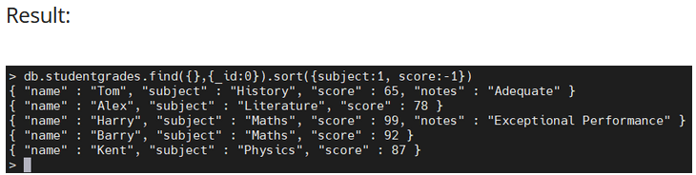
The index would create a data structure similar to the following:
db.studentgrades.find({},{_id:0}).sort({subject:1, score:-1})

Slide 14
Multikey index
MongoDB supports indexing array fields. When you create an index for a field containing an array, MongoDB will create separate index entries for every element in the array.
These multikey indexes enable users to query documents using the elements within the array.
MongoDB will automatically create a multikey index when encountered with an array field without requiring the user to explicitly define the multikey type.
Let’s create a new data set containing an array field to demonstrate the creation of a multikey index.

Slide 15
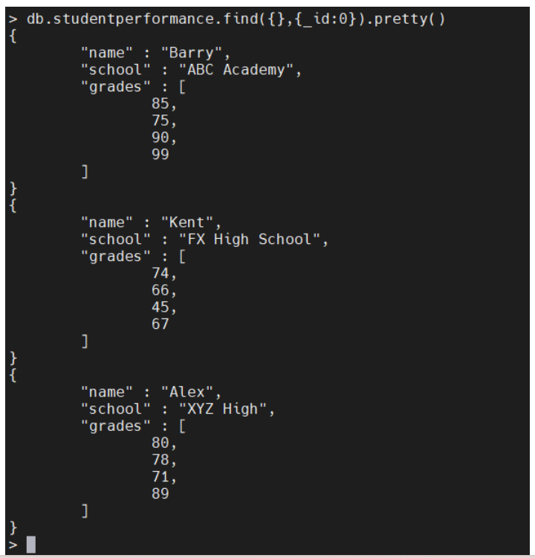
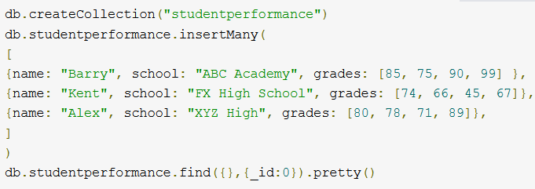

Slide 16
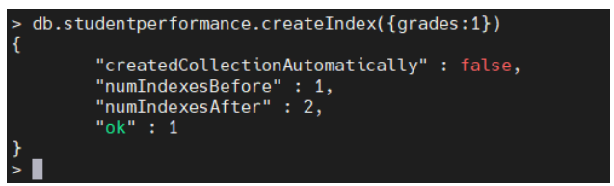

Now let’s create an index using the grades field.
The above code will automatically create a Multikey index in MongoDB. When you query for a document using the array field (grades), MongoDB will search for the first element of the array defined in the find() method and then search for the whole matching query.

Slide 17
Other MongoDB index types
Geospatial Index
MongoDB provides two types of indexes to increase the efficiency of database queries when dealing with geospatial coordinate data:
2d indexes that use planar geometry which is intended for legacy coordinate pairs used in MongoDB 2.2 and earlier.
2dsphere indexes that use spherical geometry.
2. Text index
The text index type enables you to search the string content in a collection.
3. Hashed index
MongoDB Hashed index type is used to provide support for hash-based sharding functionality. This would index the hash value of the specified field.

Slide 18
Sharding

Slide 19
What is sharding?
Sharding is the process of distributing data across multiple hosts. In MongoDB, sharding is achieved by splitting large data sets into small data sets across multiple MongoDB instances.
How sharding works…
When dealing with high throughput applications or very large databases, the underlying hardware becomes the main limitation. High query rates can stress the CPU, RAM, and I/O capacity of disk drives resulting in a poor end-user experience.
To mitigate this problem, there are two types of scaling methods.
Vertical Scaling
Horizontal Scaling - MongoDB supports horizontal scaling through sharding

Slide 20
MongoDB sharding basics
MongoDB sharding works by creating a cluster of MongoDB instances consisting of at least three servers. That means sharded clusters consist of three main components:
The shard
Mongos
Config servers

Slide 21
Shard :
A shard is a single MongoDB instance that holds a subset of the sharded data. Shards can be deployed as replica sets to increase availability and provide redundancy. The combination of multiple shards creates a complete data set. For example, a 2 TB data set can be broken down into four shards, each containing 500 GB of data from the original data set.
Mongos
Mongos act as the query router providing a stable interface between the application and the sharded cluster. This MongoDB instance is responsible for routing the client requests to the correct shard.
Config Servers
Configuration servers store the metadata and the configuration settings for the whole cluster.

Slide 22
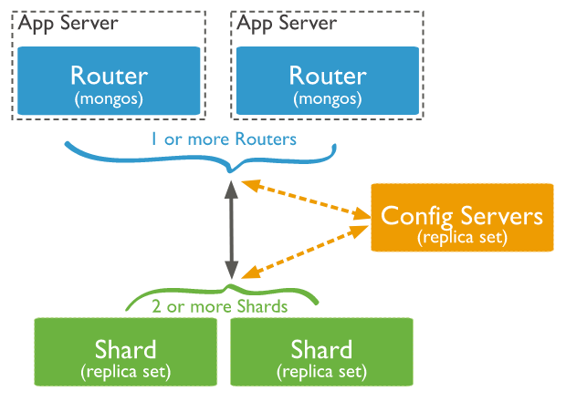
Components illustration:
Notes:
The application communicates with the routers (mongos) about the query to be executed.
The mongos instance consults the config servers to check which shard contains the required data set to send the query to that shard.
Finally, the result of the query will be returned to the application.

Slide 23
Find out
Benefits of sharding
Limitation of sharding in MongoDB

Slide 24
MongoDB Replication: A Complete Introduction

Slide 25
What is MongoDB Replication?
MongoDB replication is the process of creating a copy of the same data set in more than one MongoDB server.
This can be achieved by using a Replica Set. A replica set is a group of MongoDB instances that maintain the same data set and pertain to any mongod process.
Replication enables database administrators to provide:
Data redundancy
High availability of data
Replication can also be used as a part of load balancing, where read and write operations can be distributed across all the instances depending on the use case.
Notes:
Maintaining multiple MongoDB servers with the same data provides distributed access to the data while increasing the fault tolerance of the database by providing backups.

Slide 26
How MongoDB replication works
MongoDB handles replication through a Replica Set, which consists of multiple MongoDB nodes that are grouped together as a unit.
A Replica Set requires a minimum of three MongoDB nodes:
One of the nodes will be considered the primary node that receives all the write operations.
The others are considered secondary nodes. These secondary nodes will replicate the data from the primary node.

Slide 27
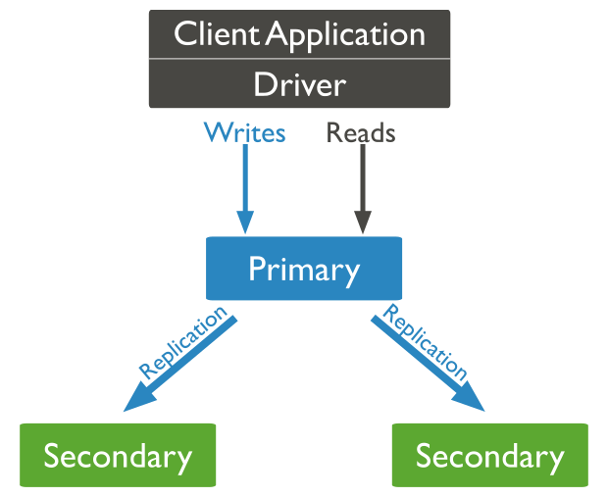
While the primary node is the only instance that accepts write operations, any other node within a replica set can accept read operations.
These can be configured through a supported MongoDB client.
In an event where the primary node is unavailable or inoperable, a secondary node will take the primary node’s role to provide continuous availability of data.
In such a case, the primary node selection is made through a process called Replica Set Elections, where the most suitable secondary node is selected as the new primary node.

Slide 28
The Heartbeat process
Heartbeat is the process that identifies the current status of a MongoDB node in a replica set.
There, the replica set nodes send pings to each other every two seconds (hence the name).
If any node doesn’t ping back within 10 seconds, the other nodes in the replica set mark it as inaccessible.
This functionality is vital for the automatic failover process where the primary node is unreachable and the secondary nodes do not receive a heartbeat from it within the allocated time frame.
Then, MongoDB will automatically assign a secondary server to act as the primary server

Slide 29
Replica set elections
The elections in replica sets are used to determine which MongoDB node should become the primary node. These elections can occur in the following instances:
Loss of connectivity to the primary node (detected by heartbeats)
Initializing a replica set
Adding a new node to an existing replica set
Maintenance of a Replica set using stepDown or rs.reconfig methods

Slide 30
In the process of an election, first, one of the nodes will raise a flag requesting an election, and all the other nodes will vote to elect that node as the primary node.
The average time for an election process to complete is 12 seconds, assuming that replica configuration settings are in their default values.
A major factor that may affect the time for an election to complete is the network latency, and it can cause delays in getting your replica set back to operation with the new primary node.
The replica set cannot process any write operations until the election is completed.
However, read operations can be served if read queries are configured to be processed on secondary nodes.

Slide 31
MongoDB Replica Set vs MongoDB Cluster
A replica set creates multiple copies of the same data set across the replica set nodes. The basic objective of a replica set is to:
Increase data availability
Provide a built-in backup solution
Clusters work differently. The MongoDB cluster distributes the data across multiple nodes using a shard key.
This process will break down the data into multiple pieces called shards and then copy each shard to a separate node
The main purpose of a cluster is to support extremely large data sets and high throughput operations by horizontally scaling the workload.

Slide 32
The major difference between a replica set and a cluster is:
A replica set copies the data set as a whole.
A cluster distributes the workload and stores pieces of data (shards) across multiple servers.
MongoDB allows users to combine these two functionalities by creating a sharded cluster, where each shard is replicated to a secondary server in order to provide high data availability and redundancy.

